Slide 1

SUMMER INTERNSHIP
PROJECT
Name : Bhumi Vyas
Student_ID : 202412123

Slide 2

Where Learning Meets Simplicity

Slide 3
Table of contents
01
Introduction
02
FR And NFR
03
04
05
Coding
Testing
Design
07
Lessons Learnt
Methodology
06
Snapshots
08
Summary
09

Slide 4

01
Introduction

Slide 5
Purpose
The purpose of this project is to build an educational web platform that helps admins manage courses and assignments, allows students to submit their work and set reminders, and gives super admins control over user roles — all in one centralized system.

Slide 6
Key Features
• User Authentication (Login & Registration)
• Secure code-based Course Management
• Assignment Upload/Submission with Comments
• Personalized Dashboard
• Reminder Calendar
• Student Directory
• Role-Based Controls

Slide 7

02
Functional and Non Functional Requirement

Slide 8
Funtional Requirements
Non Funtional Requirement
Secure registration & login with roles: Student, Admin, Super Admin
Admins can create/delete courses & generate access codes
Students can join courses via code & submit assignments
Admins can view, manage, and comment on submissions
Reminder calendar for both Admin and Student
Performance: Supports multiple users simultaneously
Security: JWT-based authentication with role restrictions
Usability: Clean, responsive UI across devices
Maintainability: Modular codebase for easy updates

Slide 9
03
Methodology and Development Process

Slide 10
🧩 Methodology & Process
Modular development of login, course, assignments, and calendar features
Role-based workflow design
Testing and enhancements based on feedback

Slide 11

04
Design

Slide 12
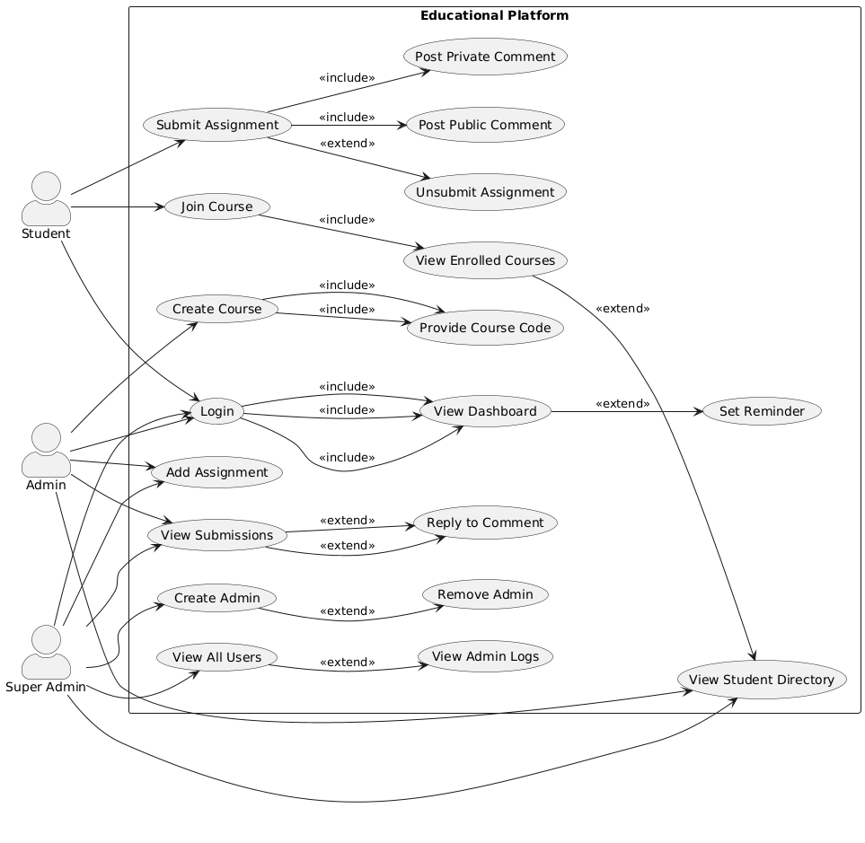

Slide 13
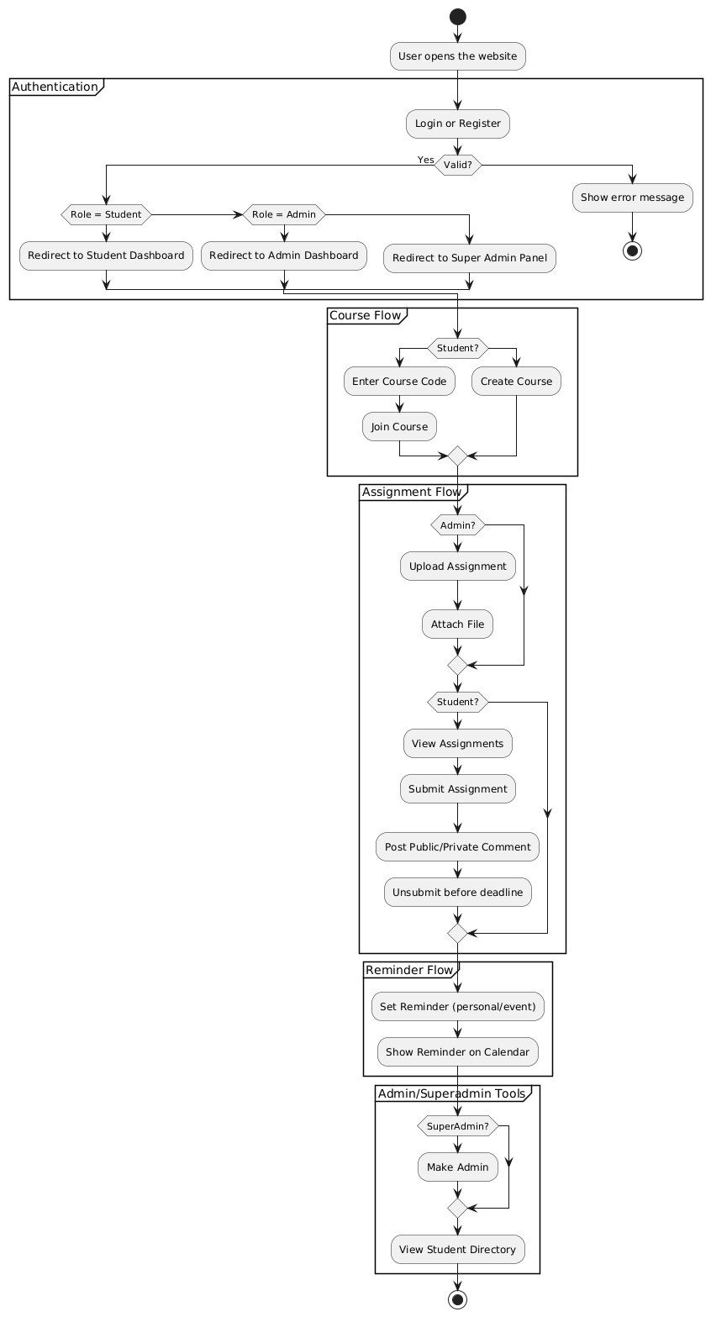

Slide 14
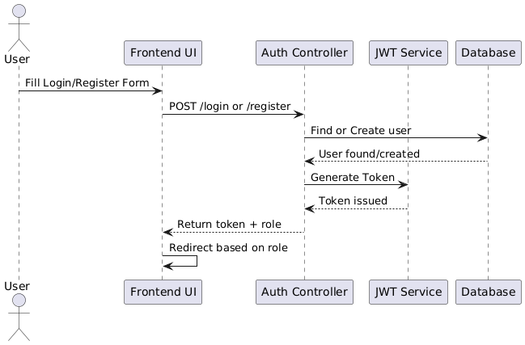

Slide 15
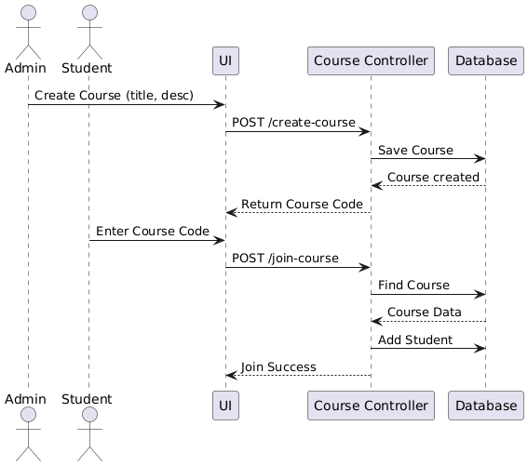

Slide 16
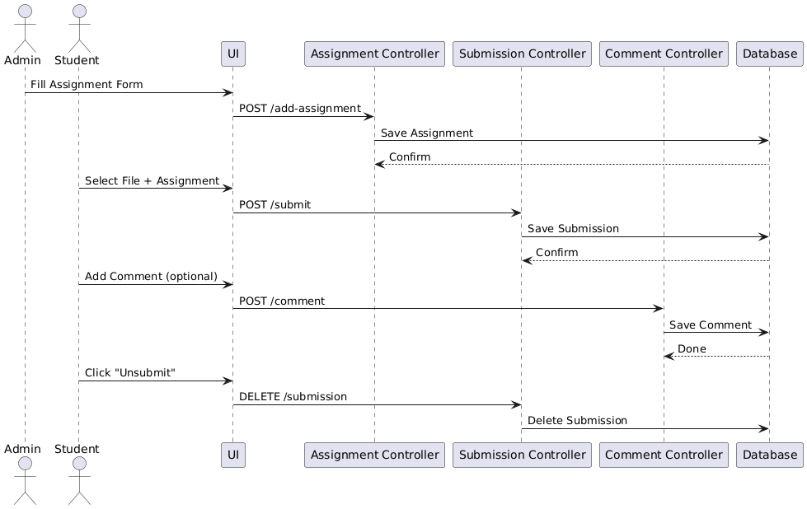

Slide 17
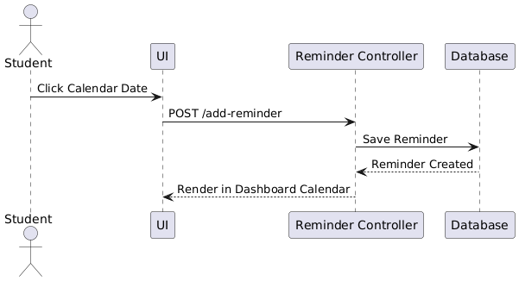

Slide 18
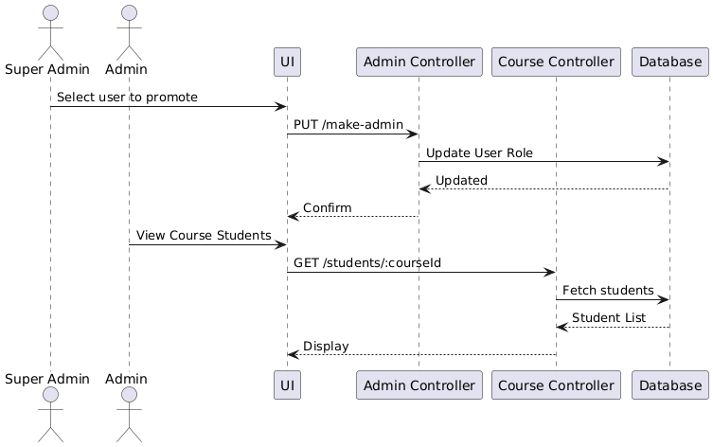

Slide 19
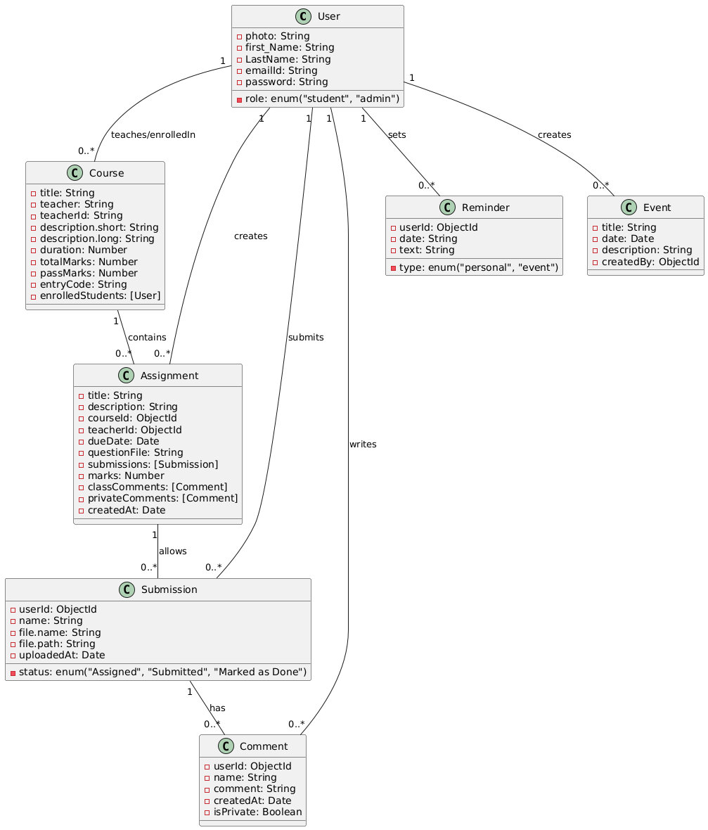

Slide 20
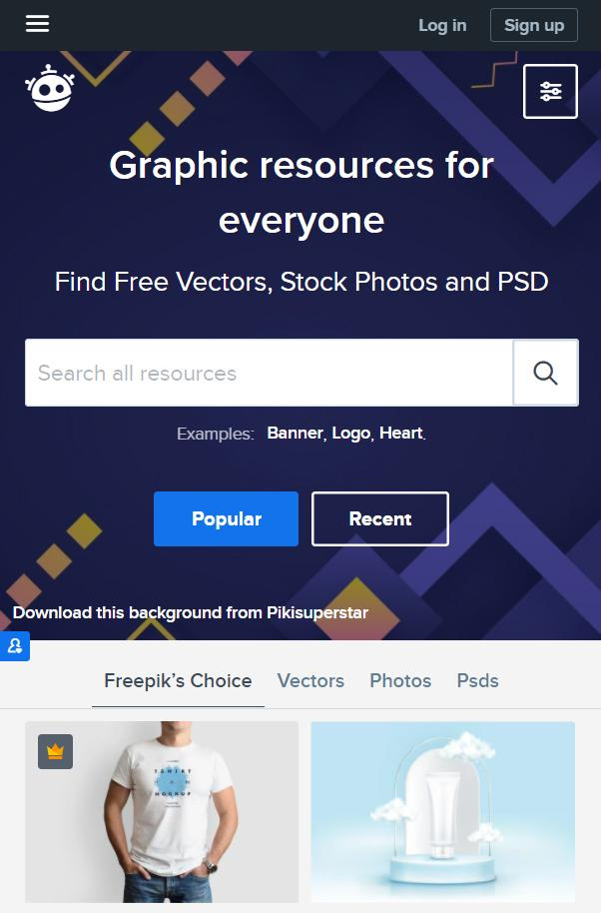
05
Coding

Slide 21

Coding (APIs & Frameworks)
Frontend:
- React.js, Tailwind CSS, Axios
Backend:
- Node.js, Express.js, MongoDB
Key APIs:
- /register, /login → Auth
- /courses, /assignments →
Management
- /reminders, /students/export → Calendar & Directory

Slide 22

06
Testing

Slide 23
1.Unit Testing
3.Manual Testing
2.Integration Testing
Individual components like user login, assignment upload, and submission logic were tested in isolation to ensure correctness
APIs were tested with real frontend requests to verify end-to-end data flow
All user roles (student, admin, super admin) were manually tested to ensure that role-based access and UI behavior functioned correctly.

Slide 24

07
Snapshot

Slide 25
Github
BhumiVyas

Slide 26
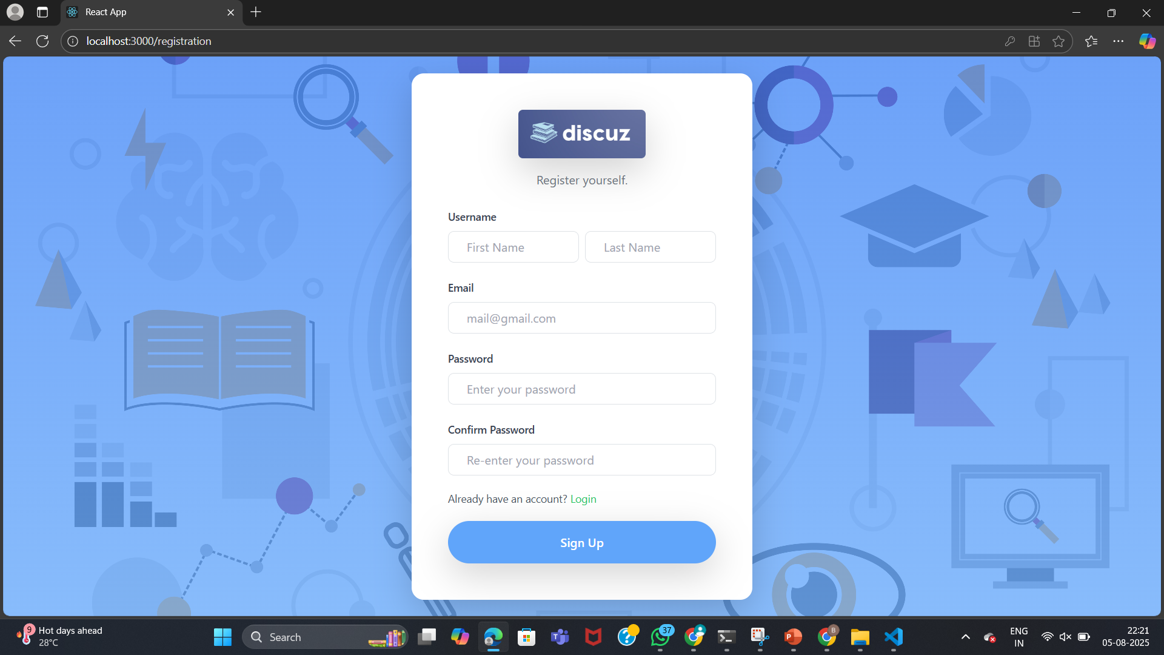
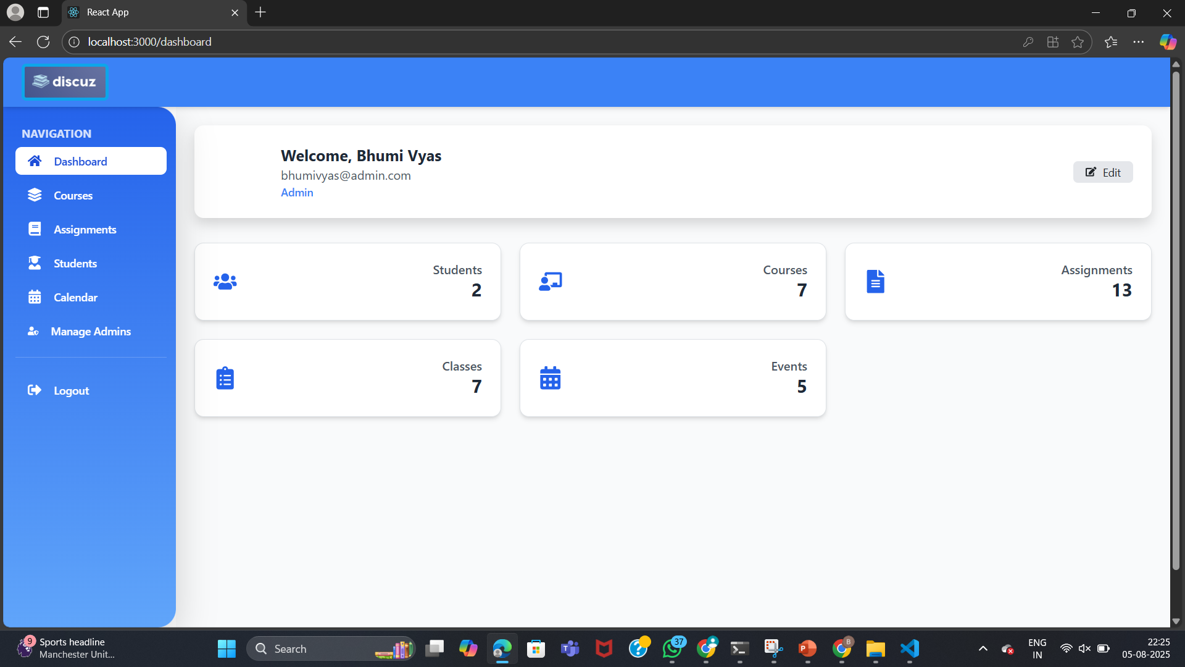
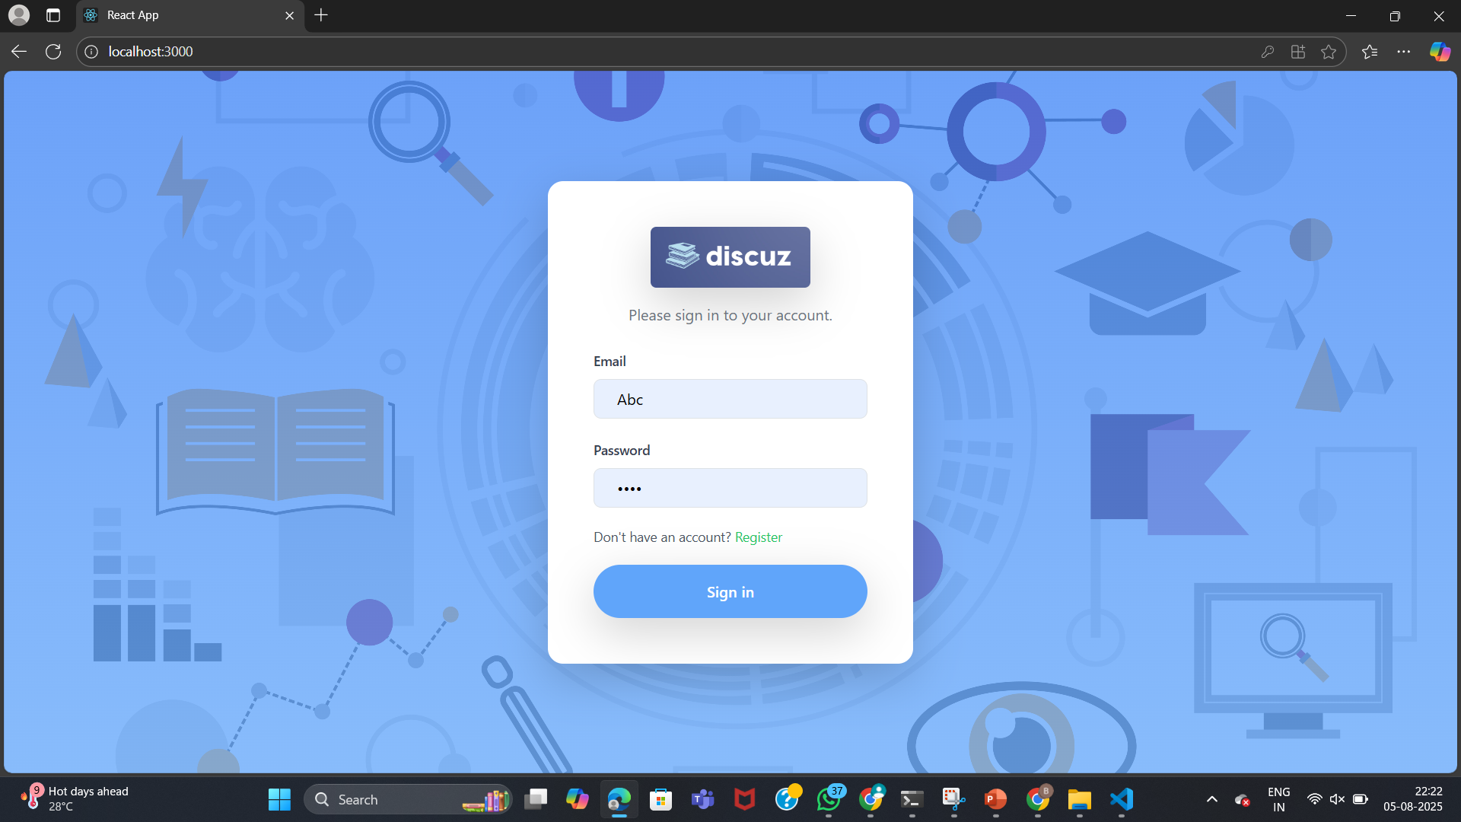
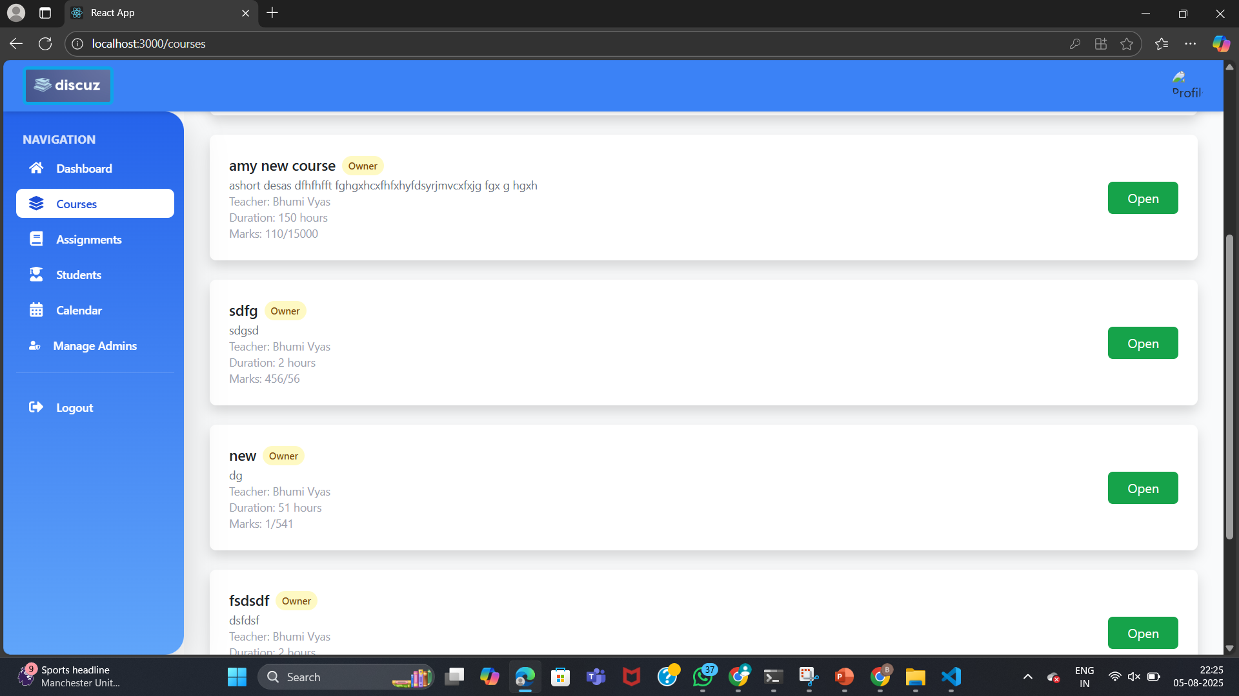

Slide 27
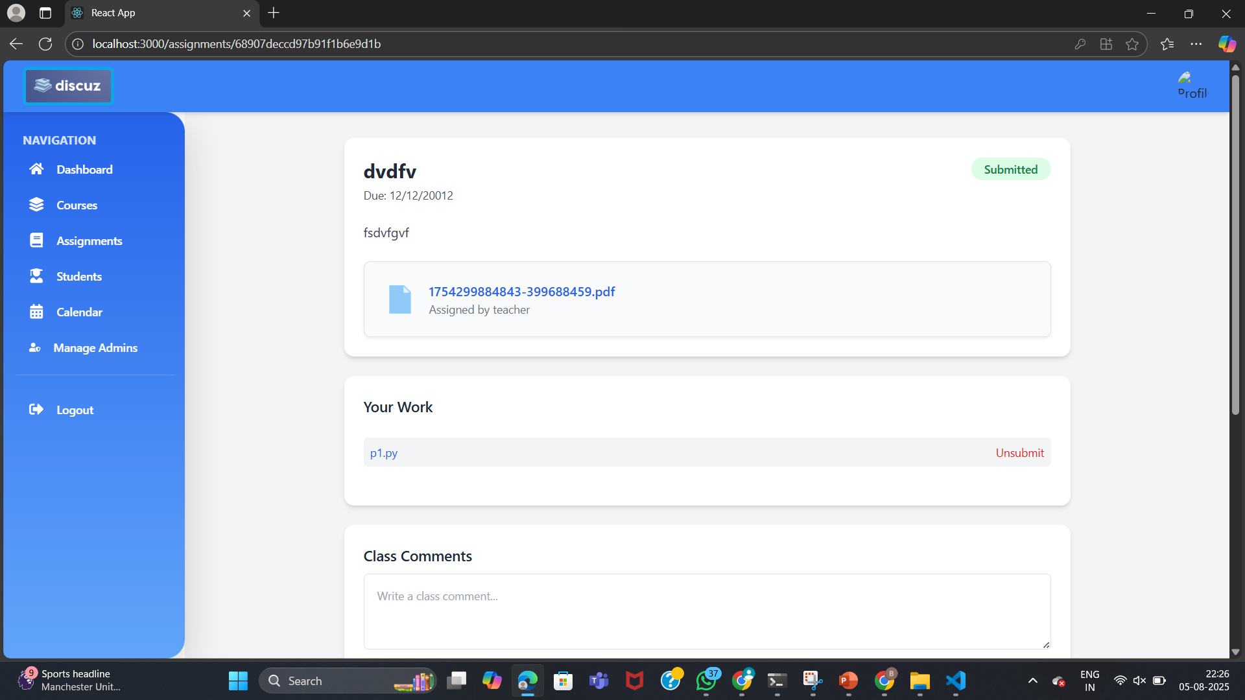
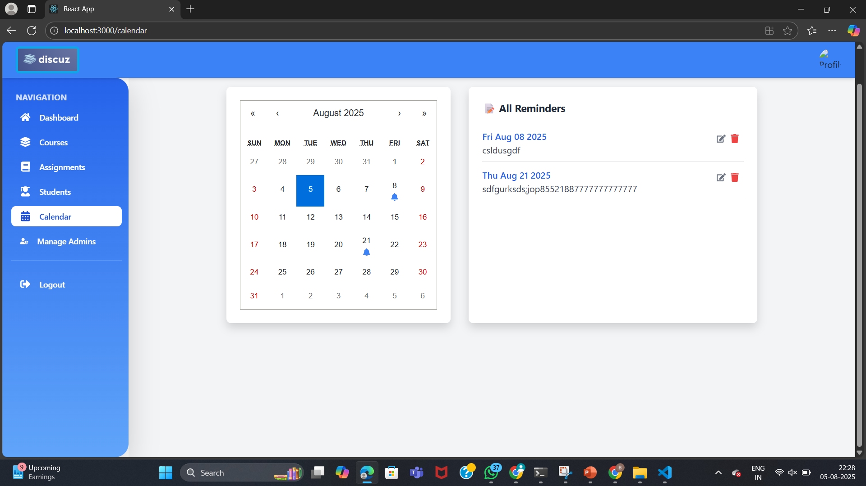
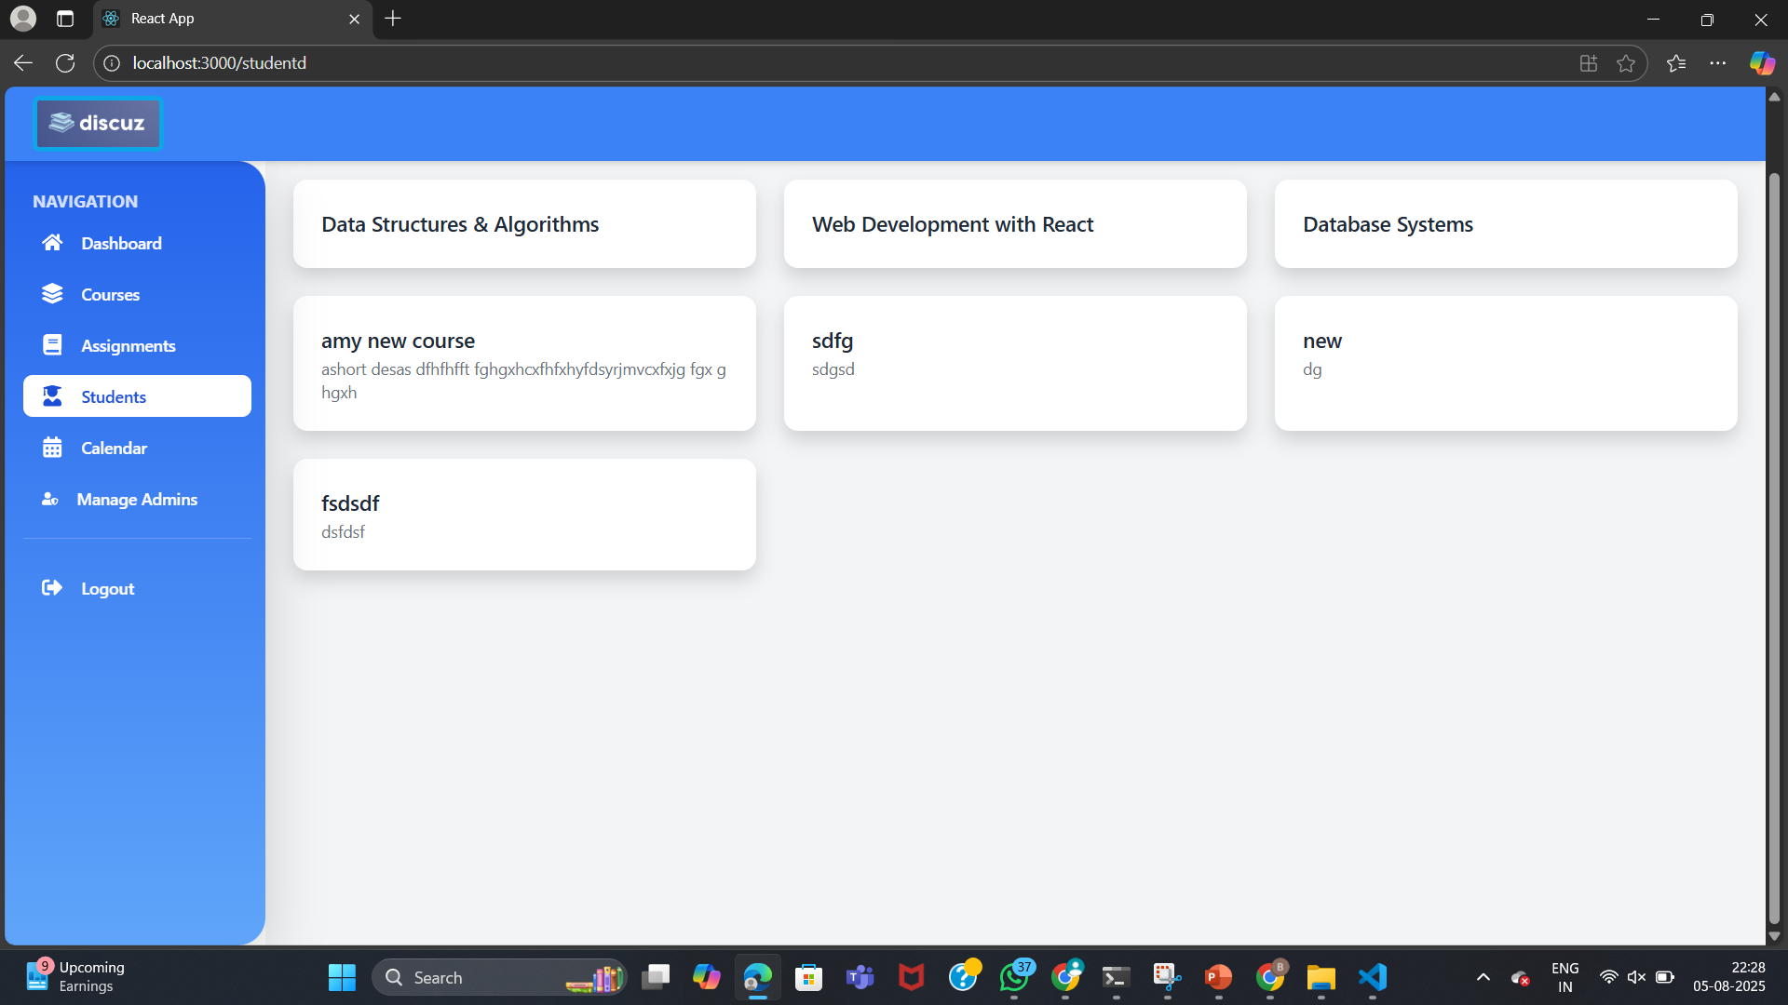
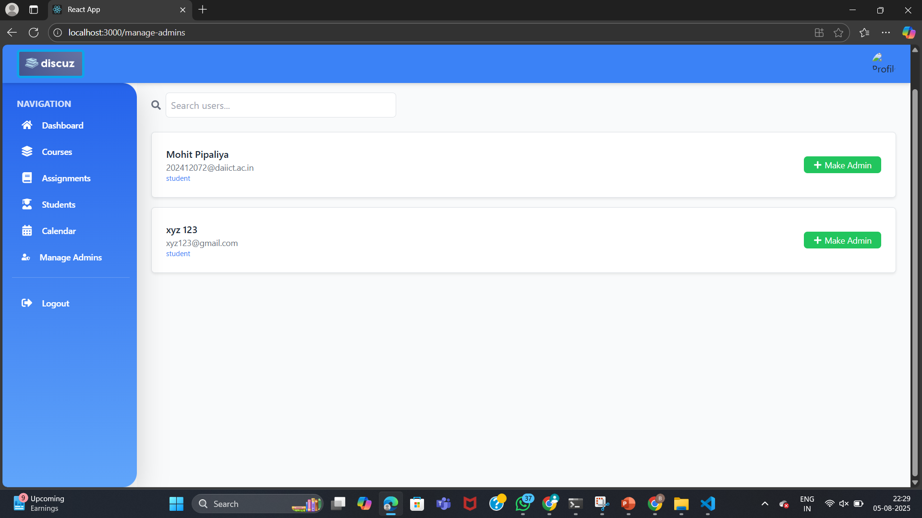

Slide 28
08 - Summary
Hi!
My name is ……………………
I am …. years old
I like …………….. and my favourite color is ……………..

Slide 29
This project is a full-stack Educational Management Web Platform designed to streamline learning, communication, and administrative workflows for students, admins, and super admins. The system supports course creation, assignment distribution, student submissions, reminders, and admin management, offering an intuitive interface and role-based access control.

Slide 30

09 Lesson Learnt

Slide 31
01
02
03
04
05
1. Learned how modular design improves code clarity and scalability.
2. Understood the importance of role-based access control for managing permissions.
3. Gained experience in MongoDB schema design, especially for nested fields.
4. frontend-backend synchronization
5. Developed a better understanding of user-centric design, focusing on practical features.

Slide 32
References
React.js Documentation
MongoDB Documentation
Node.js Documentation
Express.js Documentation

Slide 33
THANK YOU

